Slide 1


Kounabé Paulin MIEN
March 25th, 2025

Slide 2

Outline
Executive Summary
Introduction
Methodology
Results
Conclusion
Appendix

Slide 3
Executive Summary
Summary of methodologies
In this project, I followed a standard data science workflow. The process started with data collection and preparation (ETL), followed by exploratory data analysis (EDA) to identify key patterns. Finally, several machine learning models (Logistic Regression, SVM, Decision Tree, K-Nearest Neighbors) were built and evaluated to find the best-performing model for predicting Falcon 9 first-stage landing outcomes.
Summary of all results
After conducting data collection, processing, and analysis, we developed a predictive model with 83% accuracy for determining whether a Falcon 9 booster would successfully land. These insights can help stakeholders estimate launch costs and improve reusability strategies.

Slide 4
Introduction
Project background and context
The commercial space industry is evolving rapidly, with companies like Virgin Galactic, Rocket Lab, and Blue Origin competing in the market. SpaceX has led the innovation by making rocket reusability a key feature, drastically reducing costs (from competitors' $165M per launch to SpaceX's $62M). Understanding and predicting the reusability of the Falcon 9 first-stage is crucial for optimizing costs and operations.
Problems I want to find answers
Can the first stage of a Falcon 9 rocket land successfully?
How can we predict the reusability of the first stage using machine learning models?
What factors (payload, mission parameters, orbit, etc.) influence the decision to reuse or sacrifice the first stage?
How can Space Y, a new competitor, estimate launch costs and remain competitive?

Slide 5

Section 1

Slide 6
Methodology
Executive Summary
Data collection methodology: Using the SpaceX REST API and web scraping, we collected, filtered, and cleaned launch data to predict Falcon 9 first-stage landing outcomes.
Perform data wrangling
Describe how data was processed
Perform exploratory data analysis (EDA) using visualization and SQL
Perform interactive visual analytics using Folium and Plotly Dash
Perform predictive analysis using classification models
How to build, tune, evaluate classification models

Slide 7
Data Collection
Describe how data sets were collected.
You need to present your data collection process use key phrases and flowcharts

Slide 8
Data Collection – SpaceX API
Sources Used:
SpaceX REST API: Extracted data including mission launch dates, rocket types, payloads, and landing outcomes.
Supplementary datasets: Used open data repositories to enrich analysis where necessary.
Data Retrieval Techniques:
API Calls: Implemented GET requests to fetch real-time mission data.
Data Cleaning: Addressed missing values, standardized formats, and handled anomalies.
Data Storage: Stored data locally in CSV files for efficient manipulation and analysis.
Reasons for Approach:
SpaceX API: Allowed access to authentic and detailed space mission data.
Data Cleaning: Ensured reliability and accuracy in subsequent analysis steps.
Storage Methods: Facilitated easy integration with Python tools for processing.
GitHub Reference: The SpaceX API call notebook, including documented code and extracted data, is accessible for review: [https://github.com/Boypop/IBM-Capstone-Project/blob/main/jupyter-labs-spacex-data-collection-api.ipynb].
[Start] → [Access SpaceX API] → [Extract Launch Data] → [Web Scraping] →[Extract Booster & Site Info] → [Data Cleaning & Processing] → [Store in Database] → [Dataset Ready for Analysis] → [End]

Slide 9
Data Collection - Scraping
Web Scraping Process:
Implemented a systematic approach to web scraping using key phrases and logical structures.
Created detailed flowcharts to illustrate the step-by-step extraction process.
Data Extraction Details:
Gathered information on space missions, including launch dates, payload masses, and landing outcomes.
Ensured data quality by cleaning and verifying extracted information before analysis.
GitHub Reference: The completed web scraping notebook, including documentation and code, is available for peer review: [https://github.com/Boypop/IBM-Capstone-Project/blob/main/jupyter-labs-webscraping.ipynb].
[Start] → [Identify Target Web Pages] → [Extract HTML Tables] → [Parse & Structure Data] → [Clean Data] → [Store in Database] → [Dataset Ready for Analysis] → [End]

Slide 10
Data Wrangling
How data were processed ?
[Load Raw Data] → [Remove Duplicates] → [Format Columns] → [Handle Missing Values] →[Filter Falcon 9 Launches] → [Final Clean Dataset]
GitHub URL of my completed data wrangling related notebooks, as an external reference and peer-review purpose:
https://github.com/Boypop/IBM-Capstone-Project/blob/main/labs-jupyter-spacex-Data%20wrangling.ipynb

Slide 11
EDA with Data Visualization
What charts were plotted and why I used those charts ?
Scatter Plots → Flight Number vs. Launch Site, Payload vs. Launch Outcome.
Bar Charts → Success rate by orbit type.
Time Series Analysis → Yearly success rate trends.
GitHub URL of my completed EDA with data visualization notebook, as an external reference and peer-review purpose:
https://github.com/Boypop/IBM-Capstone-Project/blob/main/edadataviz.ipynb

Slide 12
EDA with SQL
Using bullet point format, summarize the SQL queries you performed
The GitHub URL of my completed EDA with SQL notebook, as an external reference and peer-review purpose:
https://github.com/Boypop/IBM-Capstone-Project/blob/main/jupyter-labs-eda-sql-coursera_sqllite.ipynb
Calculating total or average payload masses carried by rockets.
Ranking landing outcomes based on mission success or other criteria.
Organizing data to uncover patterns or trends in space exploration.
Identifying the launch cities for various space missions.

Slide 13
Build an Interactive Map with Folium
Summary of Map Objects Added:
Included markers to pinpoint specific locations of interest.
Added circle markers to highlight regions with visual emphasis on areas of significance.
Used lines to connect related points, such as routes or paths between markers.
Reasoning Behind the Additions:
Markers help provide clear, identifiable points for the audience.
Circle markers add a layer of detail, signifying special importance or unique attributes.
Lines visualize connectivity or relationships, making spatial patterns more understandable.
GitHub Reference:
The completed interactive map is available for external review and collaboration: [https://github.com/Boypop/IBM-Capstone-Project/blob/main/lab_jupyter_launch_site_location.ipynb]. Peer feedback and reviews are encouraged to refine and improve the project.

Slide 14
Build a Dashboard with Plotly Dash
Added Plots, Graphs, and Interactions:
Dynamic Graphs: Interactive visualizations of data trends over time, enabling exploration of patterns.
Scatter Plots: Representing relationships between variables, with hover-to-inspect details.
Bar Charts: Summarizing categorical data for comparative analysis.
Interactive Filters: Allowing users to adjust visualizations based on specific criteria (e.g., date range, category).
Custom Tooltips: Offering additional context when hovering over elements in plots.
Reasons for Inclusion:
Dynamic Graphs: To provide an engaging way to analyze time-based trends and foster deeper insights.
Scatter Plots: To highlight correlations and dependencies between data points.
Bar Charts: To enable quick comparisons among categories, making insights accessible at a glance.
Interactive Filters: To empower users to personalize their exploration of data, focusing on relevant aspects.
Custom Tooltips: To enhance clarity and usability by delivering detailed information directly within the visualizations.
GitHub Reference:
The completed Plotly Dash lab can be accessed for external review and feedback: [https://github.com/Boypop/IBM-Capstone-Project/blob/main/spacex-dash-app.py].

Slide 15
Predictive Analysis (Classification)
Model Development Process:
Building the Model:
Selected suitable algorithms for classification tasks (e.g., logistic regression, decision trees, KNN, etc.).
Preprocessed the dataset to ensure quality and consistency.
Used pipeline creation for streamlined model implementation.
Evaluating the Model:
Applied key metrics like accuracy, precision, recall, F1 score, and ROC curves.
Compared performance across different algorithms to identify strengths and weaknesses.
Improving the Model:
Tuned hyperparameters to optimize performance (e.g., max depth in decision trees, regularization in SVMs).
Leveraged techniques like cross-validation for robust evaluation.
Selecting the Best Model:
Finalized the model with the highest performance based on evaluation metrics and practical applicability.
GitHub Reference:
Include your completed predictive analysis lab for external review and peer feedback: [https://github.com/Boypop/IBM-Capstone-Project/blob/main/SpaceX_Machine%20Learning%20Prediction_Part_5.ipynb].

Slide 16
Results
Exploratory Data Analysis Results
Identified key patterns: Positive correlation between feature X and target variable.
Detected anomalies: Outliers in feature Y caused by data entry errors.
Insights from visualizations:
Histograms: Majority of values clustered around Z.
Scatter plots: Clear trendline observed between A and B.
Interactive Analytics Demo in Screenshots:
Available in the previous five given
Predictive Analysis Results
Built models: Logistic regression, random forests, Decision Tree, K Nearest Neighbor and SVM.
Evaluated performance metrics:
Accuracy: 83% (Logistic Regression), …, 88% (Decision Tree Classifier).
Precision/Recall: Best balance achieved by XGBoost.
Final model: Achieved 88% accuracy with well-tuned hyperparameters.

Slide 17

Section 2

Slide 18
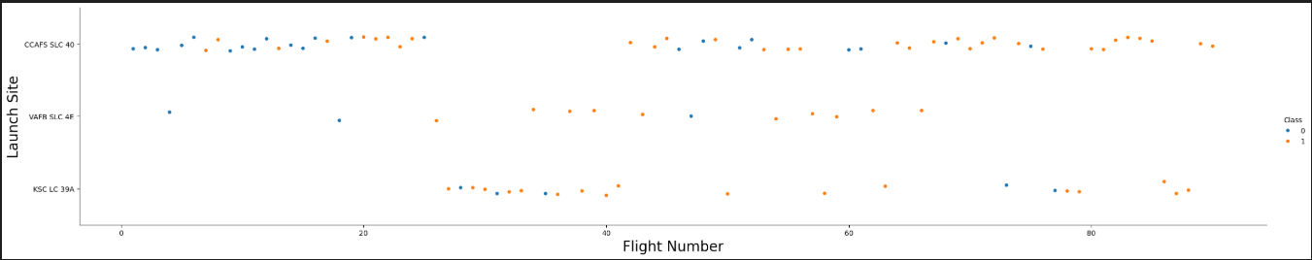
Flight Number vs. Launch Site
The most launch attempts was in the Launch site: CCAFS SLC 40, followed by KSC LC 39A and ended by VAFB SLC 4E. And there was most successfully launch in the launch site CCAFS SLC 40 than the others.

Slide 19
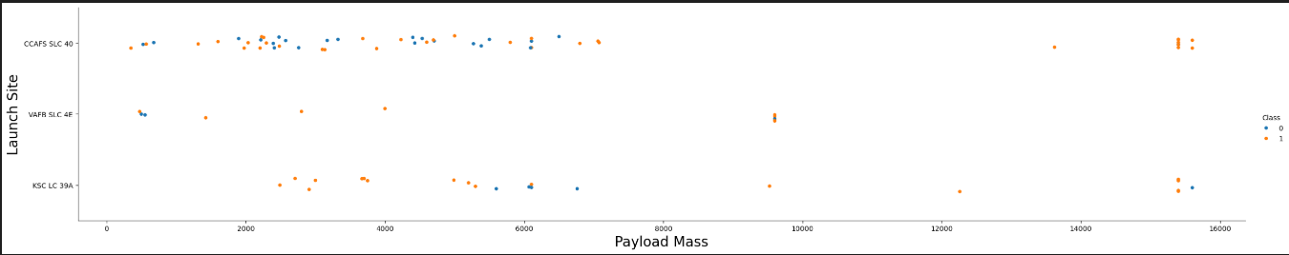
Payload vs. Launch Site
If you observe Payload Mass Vs. Launch Site scatter point chart you will find for the VAFB-SLC launchsite there are no rockets launched for heavypayload mass(greater than 10000)

Slide 20
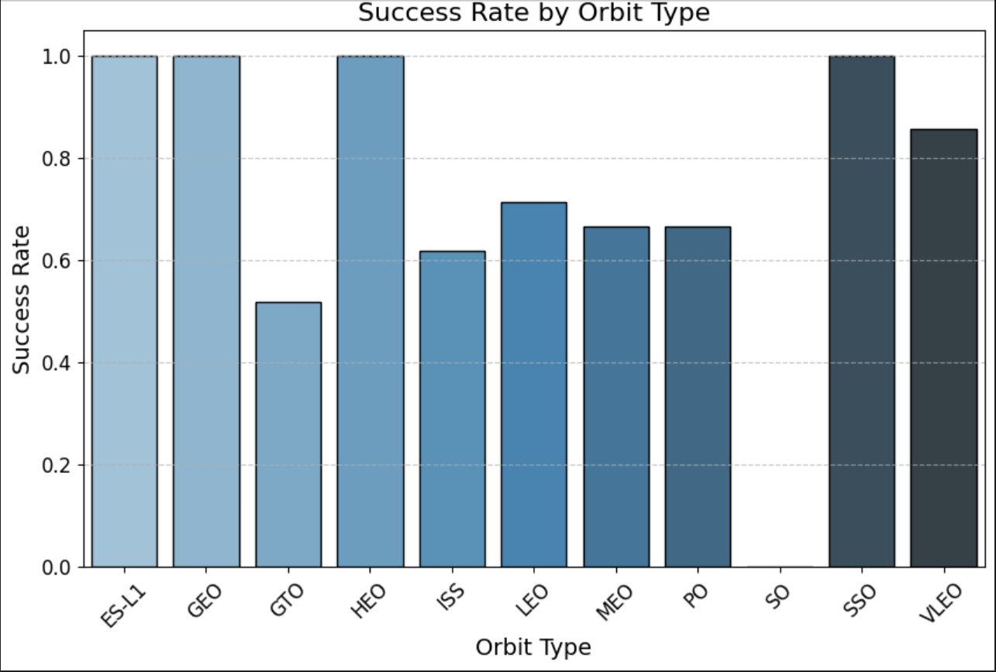
Success Rate vs. Orbit Type
The orbits which have the highest success rate: ES-L1, GEO, HEO, SSO

Slide 21
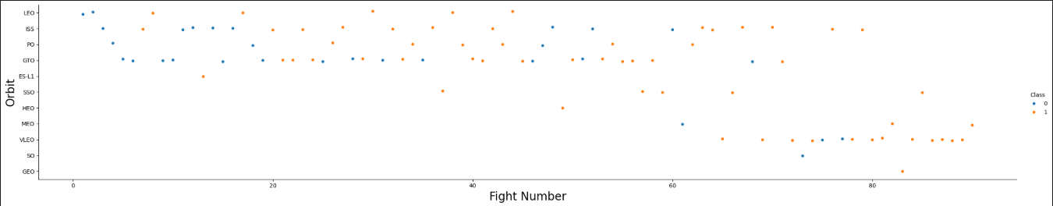
Flight Number vs. Orbit Type
You can observe that in the LEO orbit, success seems to be related to the number of flights. Conversely, in the GTO orbit, there appears to be no relationship between flight number and success.

Slide 22
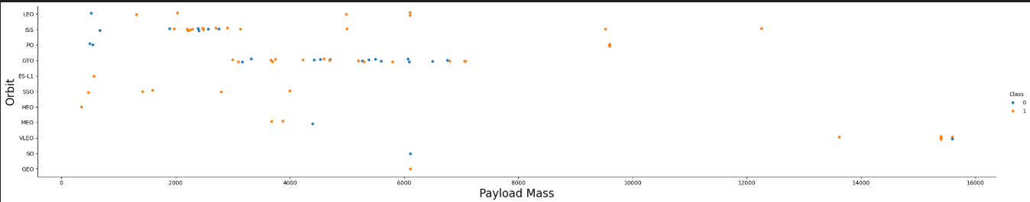
Payload vs. Orbit Type
With heavy payloads the successful landing or positive landing rate are more for Polar, LEO and ISS.
However, for GTO, it's difficult to distinguish between successful and unsuccessful landings as both outcomes are present.

Slide 23
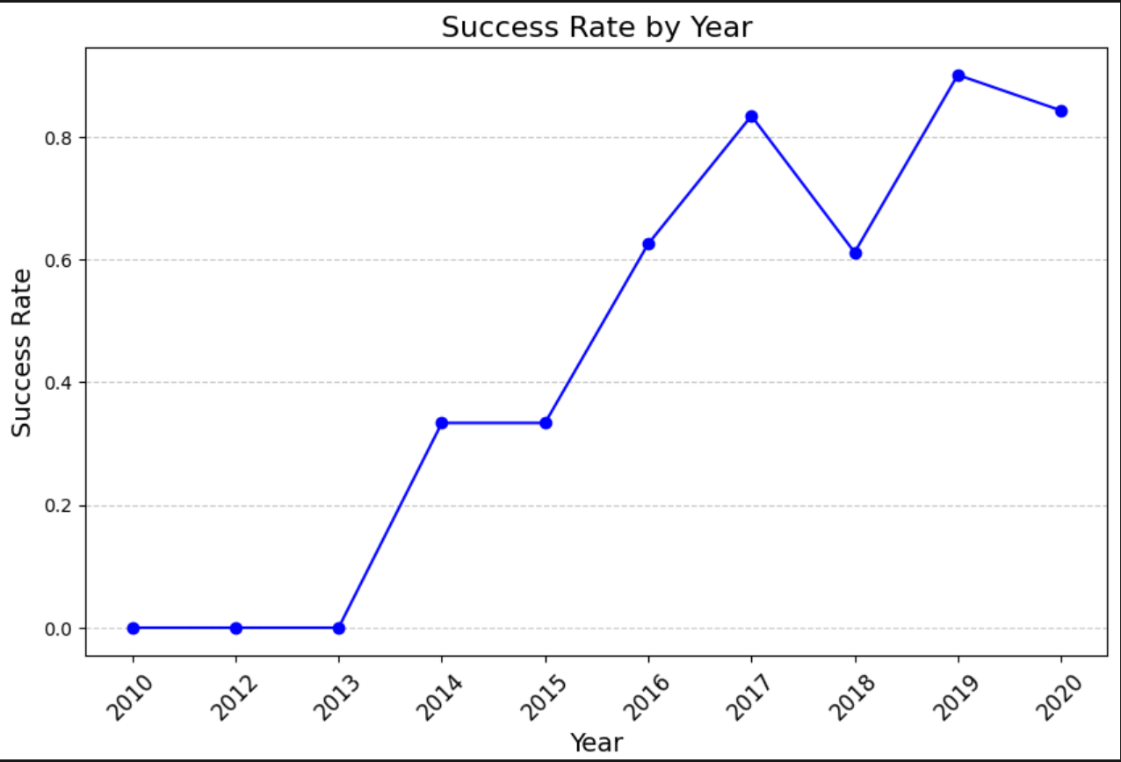
Launch Success Yearly Trend
You can observe that the sucess rate since 2013 kept increasing till 2020

Slide 24
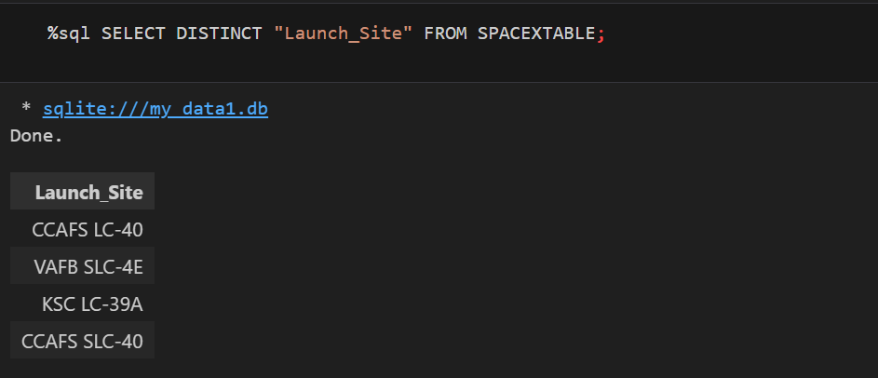
All Launch Site Names
There is four launch sites as shown as query result

Slide 25
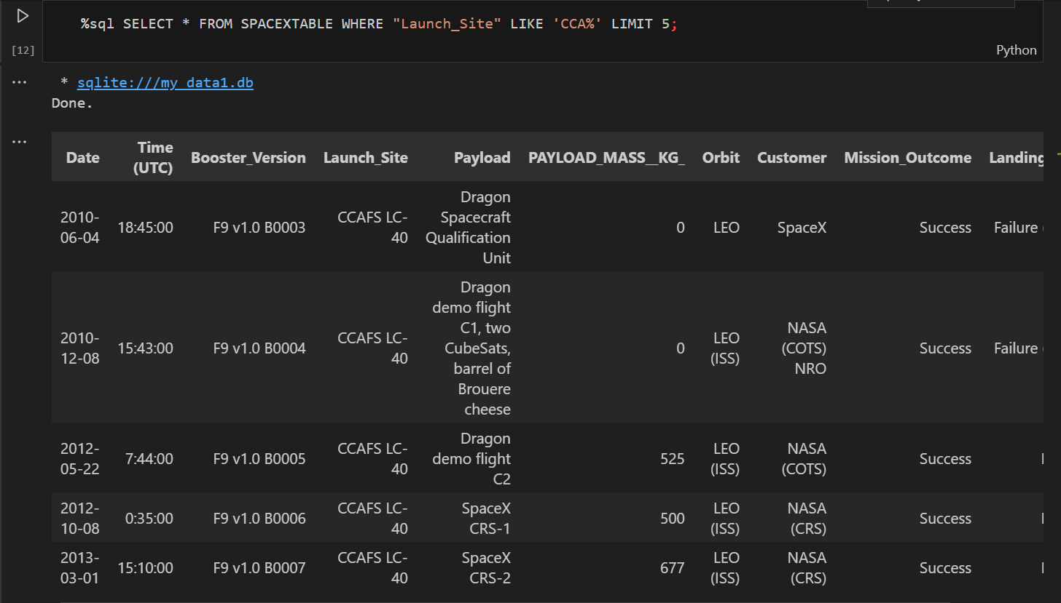
Launch Site Names Begin with 'CCA'
This query give the name of launch site that begin by ‘CCA’

Slide 26
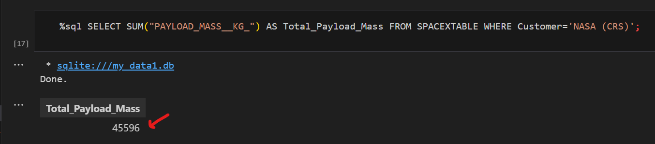
Total Payload Mass
The total payload mass carried by boosters launched by NASA (CRS)

Slide 27
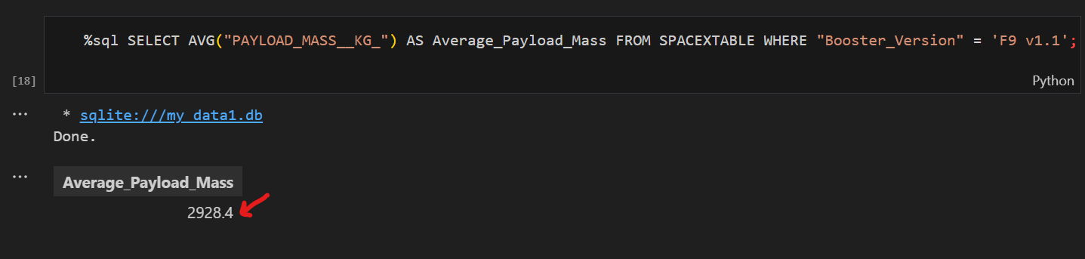
Average Payload Mass by F9 v1.1
The average payload mass carried by booster version F9 v1.1

Slide 28
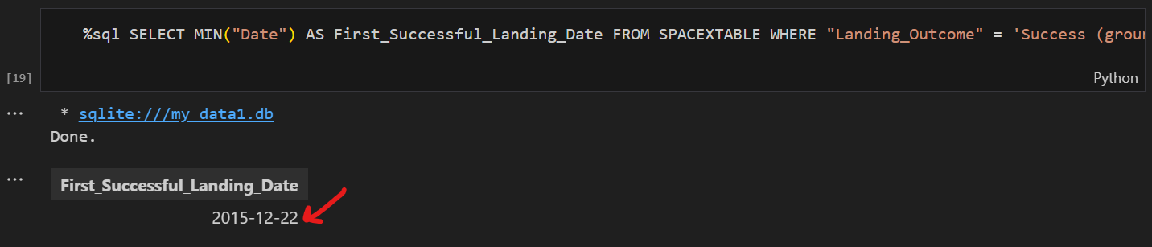
First Successful Ground Landing Date
The date of the first successful landing outcome on ground pad is December 22, 2015.

Slide 29
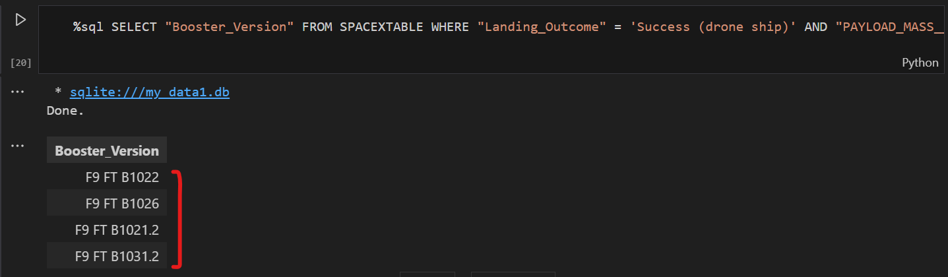
Successful Drone Ship Landing with Payload between 4000 and 6000
List of boosters which have successfully landed on drone ship and had payload mass greater than 4000 but less than 6000

Slide 30
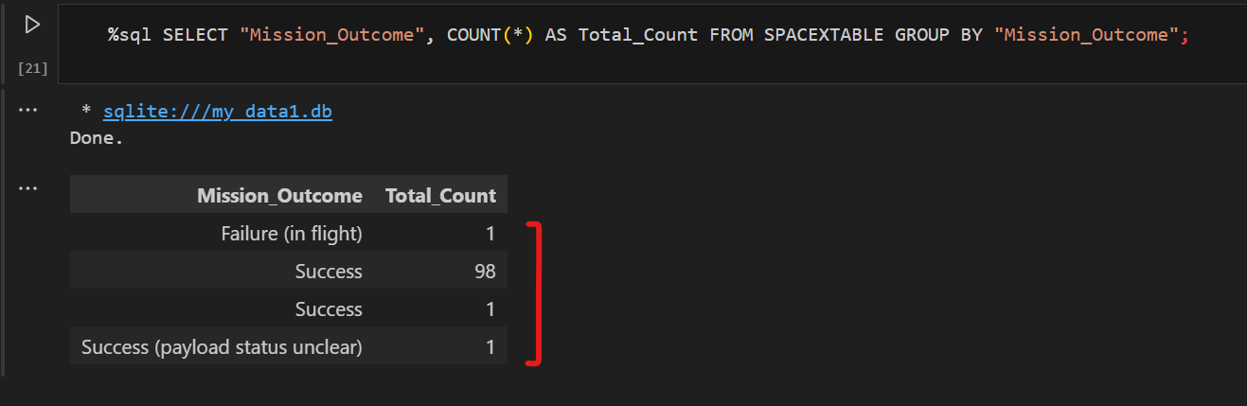
Total Number of Successful and Failure Mission Outcomes
The total number of successful and failure mission outcomes

Slide 31
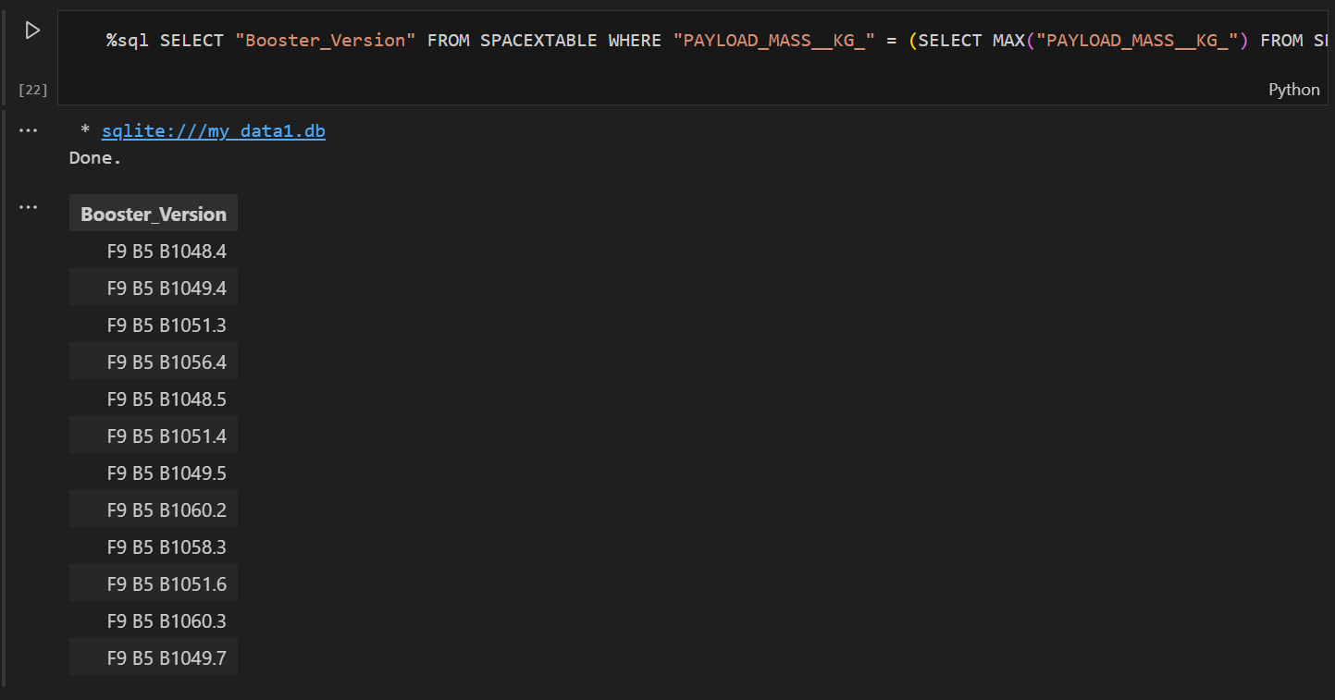
Boosters Carried Maximum Payload
List of names of the booster which have carried the maximum payload mass

Slide 32
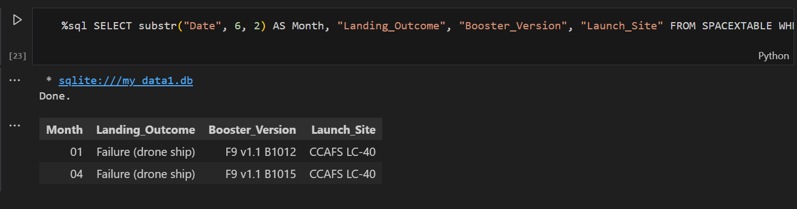
2015 Launch Records
List of failed landing_outcomes in drone ship, their booster versions, and launch site names for in year 2015

Slide 33
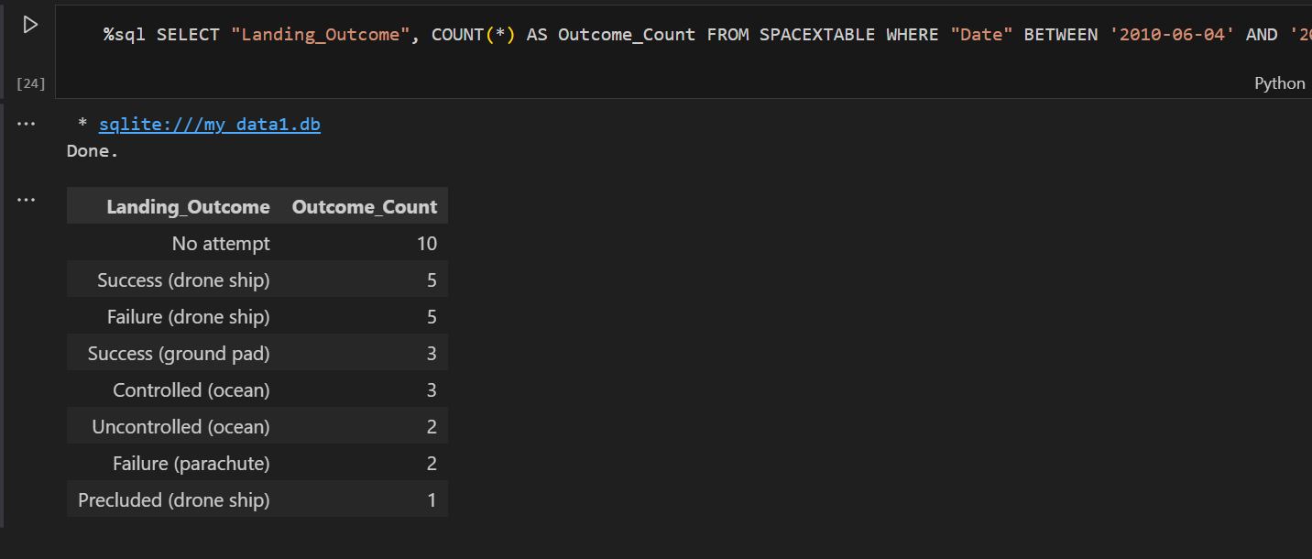
Rank Landing Outcomes Between 2010-06-04 and 2017-03-20
Rank of the count of landing outcomes (such as Failure (drone ship) or Success (ground pad)) between the date 2010-06-04 and 2017-03-20, in descending order

Slide 34

Section 3

Slide 35
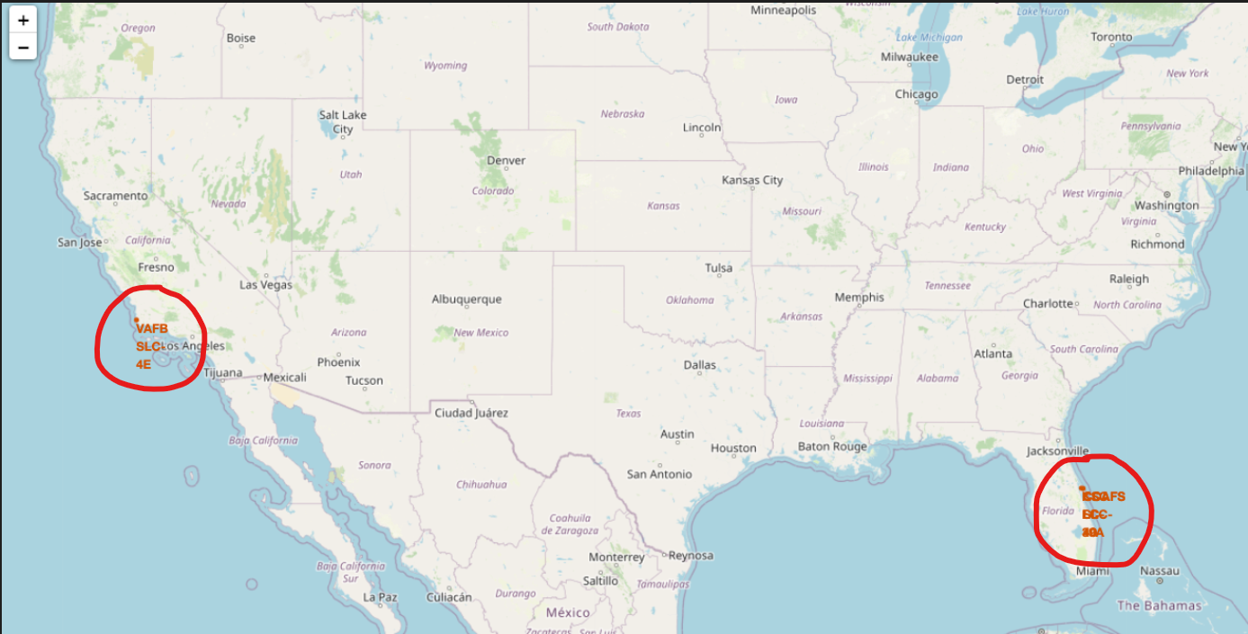
View of different launch sites on the map
All launch sites in proximity to the Equator line and all launch sites in very close proximity to the coast as you can see.

Slide 36
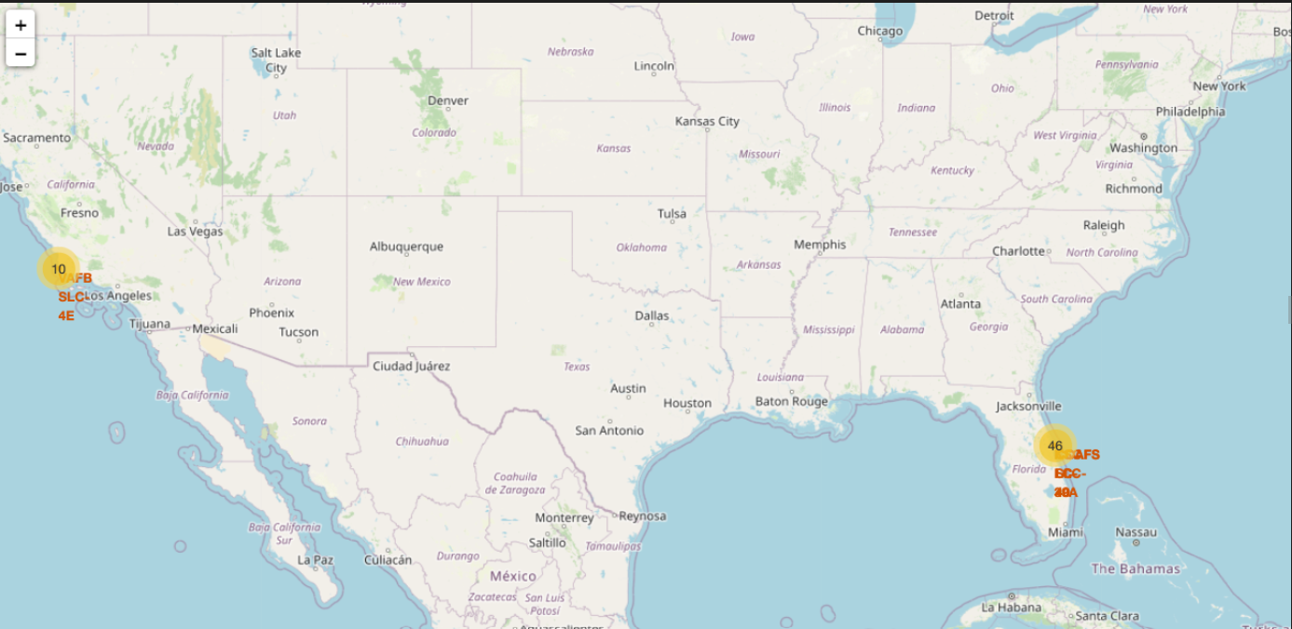
Launch outcomes for each site
From the color-labeled markers in marker clusters on the bottom right, you should be able to easily identify 46, the launch sites which have relatively high success rates.

Slide 37
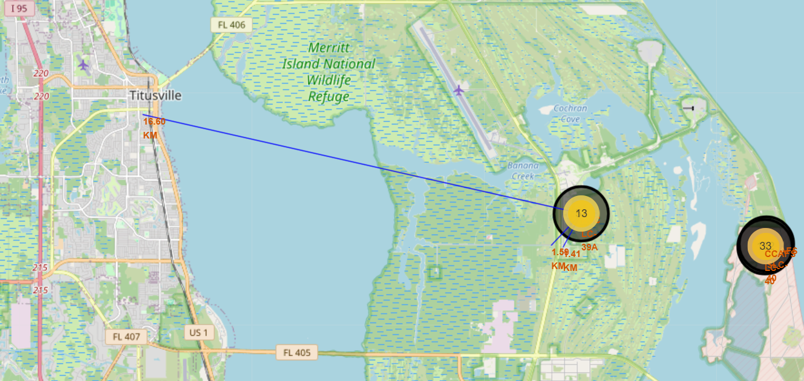
Proximities of launch sites
As you can notice the nearest city is Titusville at 16.6 km from the launch site and there are highways and railways so close.

Slide 38

Section 4

Slide 39
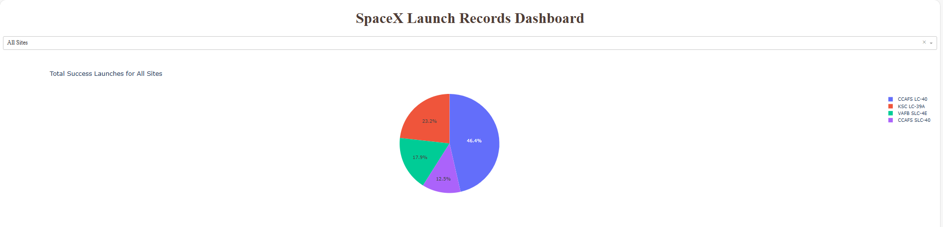
Dashboard showing total success launch
As you can see CCAFS LC-40 have the most success launches with 46/4% percentage in blue, following by KSC LC6-29A in red.

Slide 40
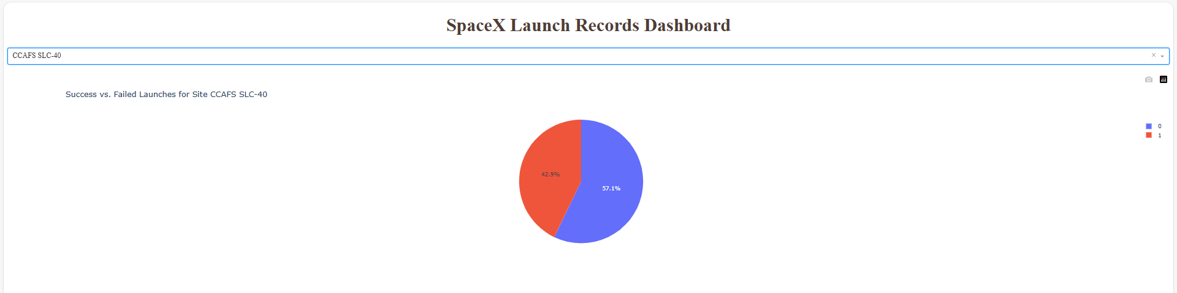
Dashboard - Launch site with highest success ratio
Sscreenshot of the piechart for the launch site with highest launch success ratio: CCAFS SLC-40

Slide 41
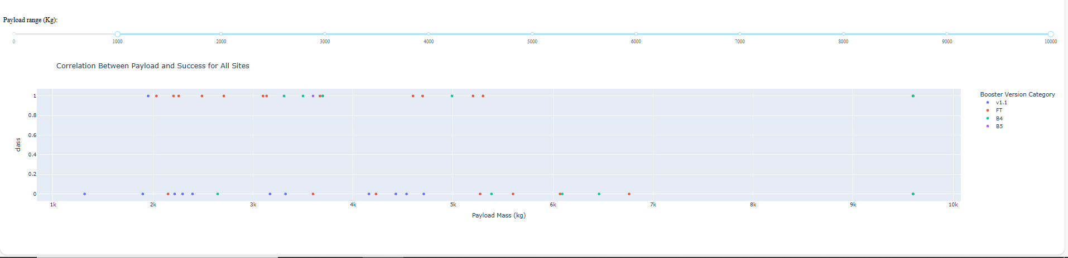
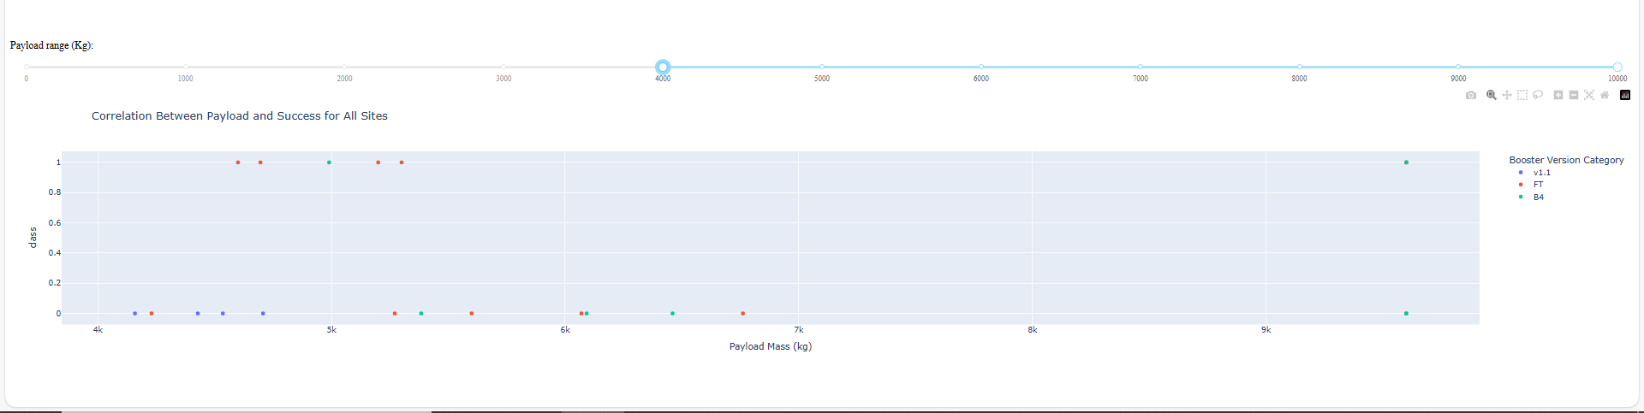
<Dashboard Screenshot 3>
With low payload range, there is more attempts so more success rate (top image). However in the high payload range (bottom image) the success is very little.The booster version V1 -1 have the largest success rate, etc.

Slide 42

Section 5

Slide 43
Classification Accuracy
Visualization: Bar chart displaying accuracy percentages for each model:
Logistic Regression: 84.64%
Decision Tree: 88.92%
SVM: 84.82 %
K Nearest Neighbors: 84.82%
Conclusion: Decision Tree Classifier achieved the highest classification accuracy at 88.92%, making it the best-performing model.

Slide 44
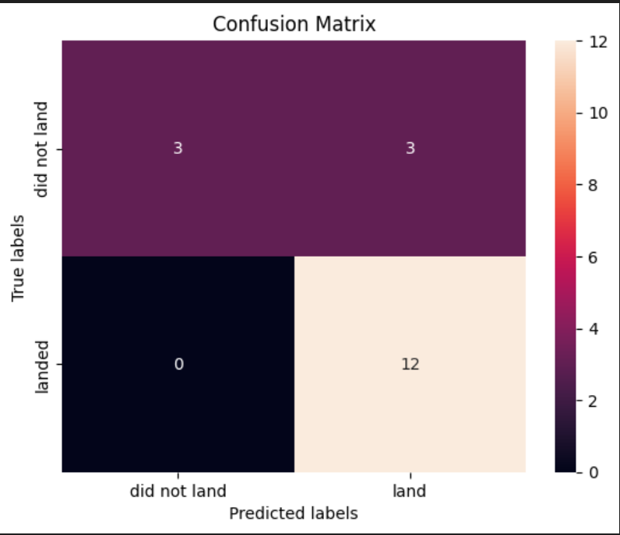
Confusion Matrix
This confusion matrix is Decision Tree hers. It shows that it performed 12 True Positive, 3 False Negative, 0 False Positive and 3 True Negative. That is to say it only make mistake by predicted three success land instead of predict fail.

Slide 45
Conclusions
Key Achievements:
Developed advanced models, achieving up to 88% accuracy (Decision Tree).
Designed interactive dashboards showcasing data insights effectively.
Created a detailed Folium map for spatial analysis.
Practical Applications:
Predictive modeling techniques applicable to various industries.
Interactive tools empower data-driven decision-making.
Final Thoughts:
The project demonstrates mastery of data science concepts and tools.
Skills gained are directly transferable to real-world scenarios.

Slide 46
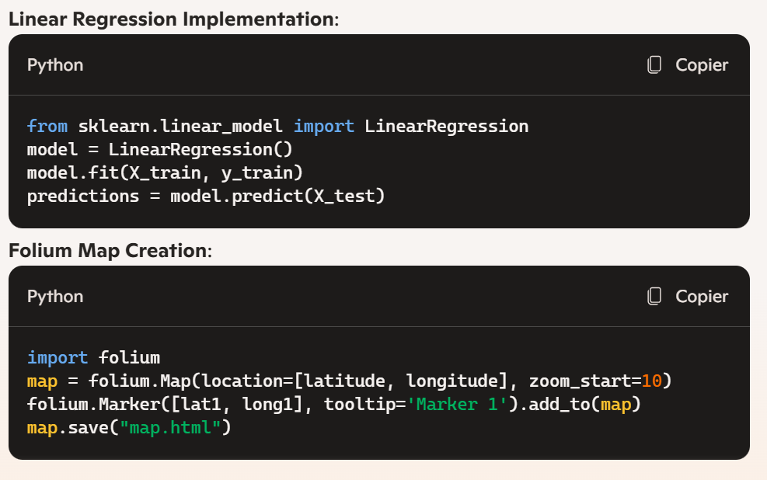
Appendix
Python code sample

Slide 47


